Slide 1
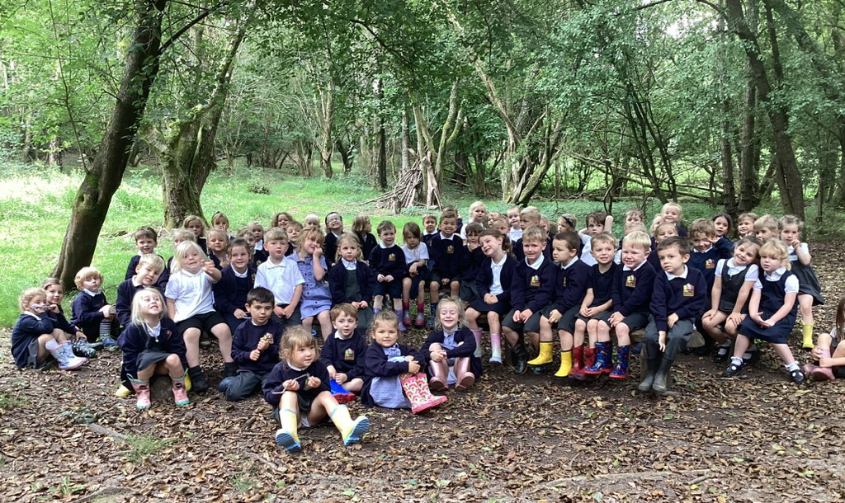
Welcome Year R

Slide 2
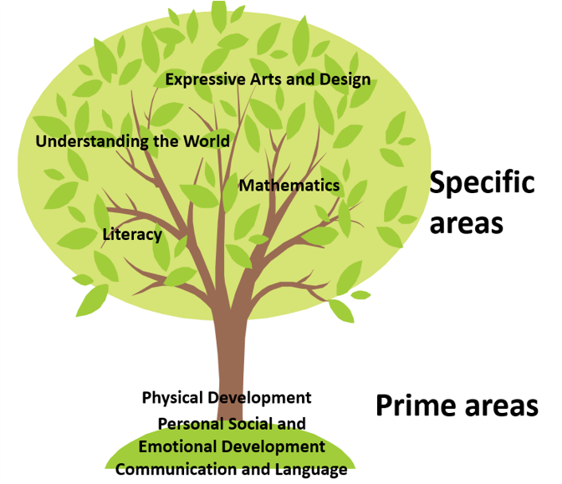

Slide 3

Year R
September 2023

Slide 4
At Foxhills Infant School we use Read, Write, Inc. to support our phonics and early reading this is a nationally recognise scheme.
Children who read, or are read to regularly have the opportunity to open the doors to so many different worlds! More importantly, reading will give your child the tools to become independent, life-long learners. Early reading starts with phonics.
Children in EYFS and KS1, as well as those children who have not passed the phonics screening check or require additional support, are taught through the structured Read, Write, Inc. programme.

Slide 5
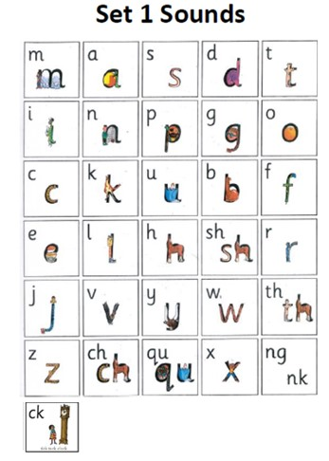
The children:
Learn 44 sounds and the corresponding letters using simple picture prompts, these are called grapheme to phoneme correspondence GPC.
Learn to read words using Fred talk and sound blending.
Read from a range of storybooks and non-fictions books matched to their phonic knowledge.
Develop comprehension skills in stories by answering 'Find It' and 'Prove It' discussion questions.

Slide 6
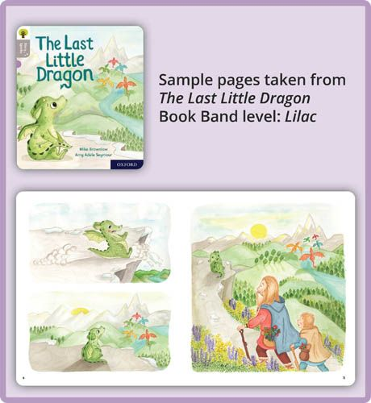
Your child’s first book
Wordless
Basics of reading (L-R)
Sound focus
Picture talk

Slide 7
Story books
Once children have learnt the initial 26 sounds and have began learning digraphs (two letters that make one sound), they will move onto a ‘Red Ditty’ group where they will receive a book to take home that contains decodable words.
These books will then be sent home following three days of story book teaching in school and, although it may seem as though children have ‘memorised’ the book, it is important to continue reading it as it allows them to build reading fluency and help commit words to memory. Additionally, it will allow children to begin to use their storyteller voices as they spend less time decoding words and more time comprehending what they are reading. This includes pausing at full stops, talking in voice of characters and with excitement and enjoyment.

Slide 8

Writing
The children:
Learn to write and form the letters which represent the 44 sounds with the help of fun phrases.
Learn to write words using Fred Talk.
Learn to build sentences by saying them out loud before writing them down.

Slide 9
How can you help at home?
By Christmas children need to know the initial 26 sounds, to help your children achieve this goal there are things you can do to help at home.
We will send home a copy of the sound learnt that day (4/5 a week). These are the sounds the children will be learning that week in phonics. It would be really helpful for your children if you could please go over these whenever you can.
Retelling stories is really important and can help with language development, they can join in with familiar phrases and begin to build confidence within story.
Do some ‘real world’ reading! Children love to read signs, menus, etc. Help them to do this when you are out and about.
Read! Reading to your children will be invaluable to their reading journey and being a reading role model with support them in their love of reading!

Slide 10
What is the Year 1 Phonics Screening Check?
The Year 1 Phonics screening check is a short, light-touch assessment to confirm whether individual pupils have learnt phonic decoding to an appropriate standard. It will identify the children who need extra help so they are given support by their school to improve their reading skills. They will then be able to retake the check in Year 2 so that schools can track pupils until they are able to decode appropriately.

Slide 11

Maths
Year R
September 2023

Slide 12
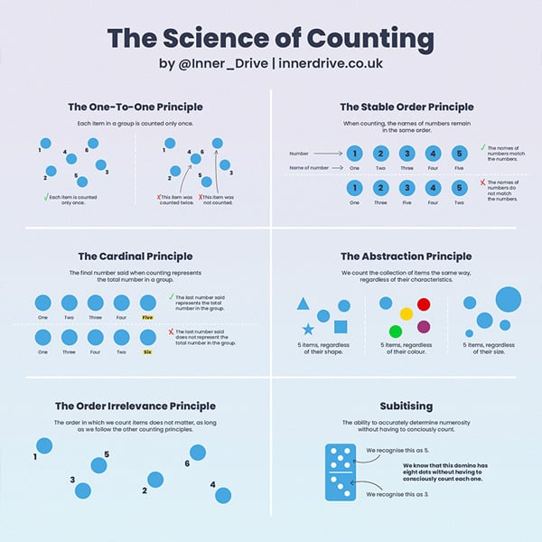
Counting
In reception we will focus on counting and cover the following principles. These support early maths and enable the secure foundations to work within number.

Slide 13
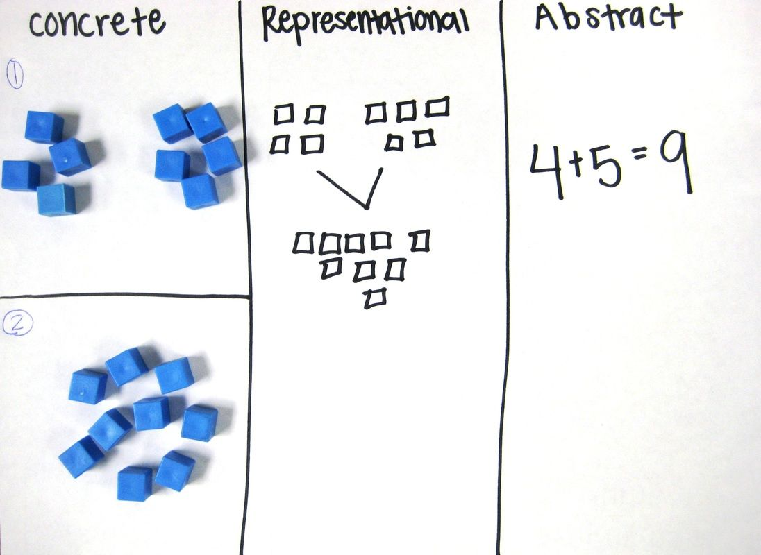
Concrete, pictorial and abstract
Any new maths concept we teach is delivered with this in mind.

Slide 14
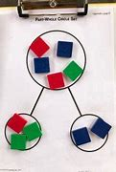
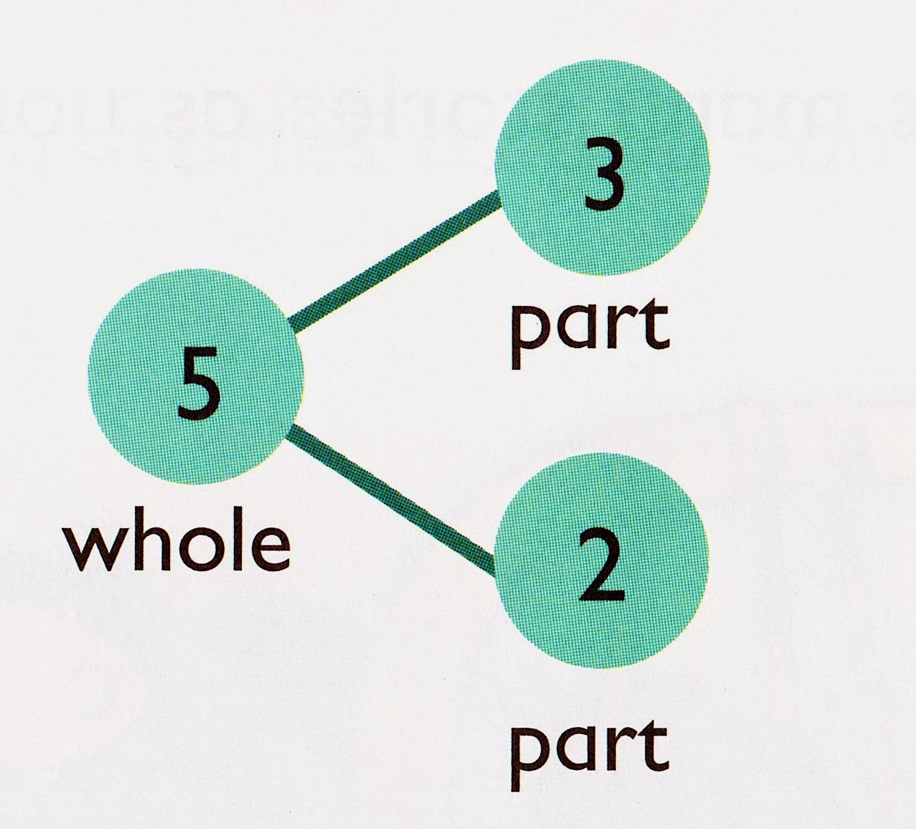
Models – Part, part, whole
Can be used concrete, pictorially or abstract.

Slide 15
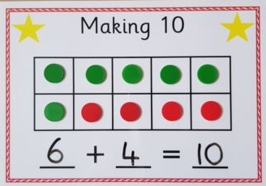
Models – tens frame
A tens frame can be used for identifying ways to make any numbers leading up to ten. Two different colour counters can really help with this.

Slide 16
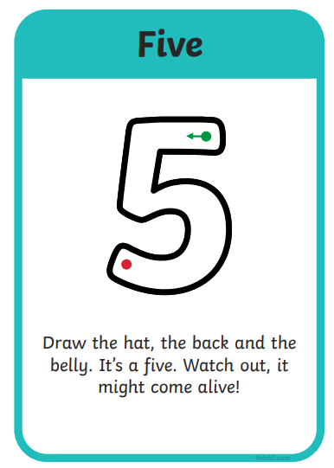
Number formation
Whilst children in reception do not need to leave the EYFS knowing number formation, we will support and allow children to write number where appropriate and allow children to begin to record their mathematical understanding.

Slide 17




Number Books

Slide 18
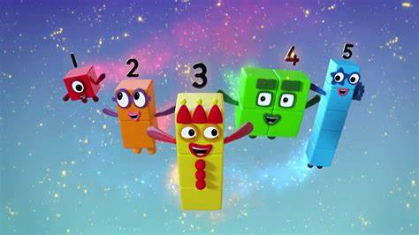
Numberblocks

Slide 19
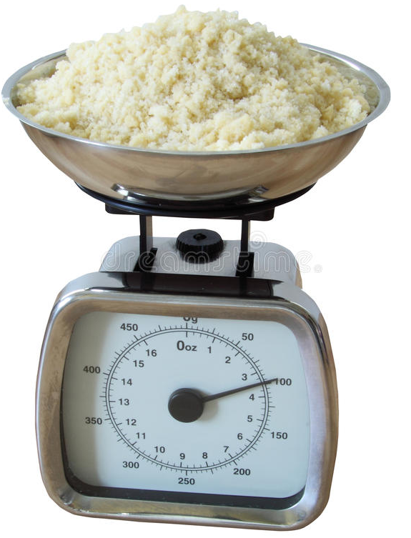

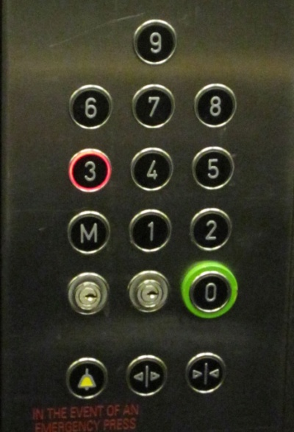
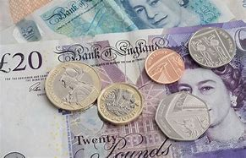
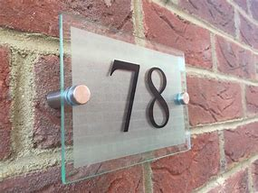
Numbers are everywhere!

Slide 20
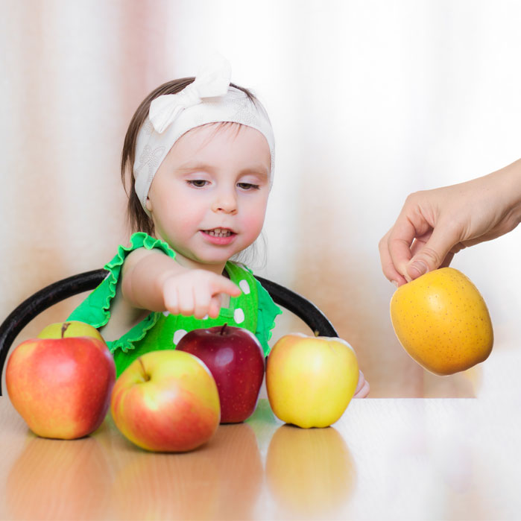


How to help at home
Counting steps
Messy play with capacity
Drawing and counting
Adding items together; dinosaurs, socks, apples!
Subtraction: creating groups and discussing what happens to the number when some are removed
MAKE IT FUN!

Slide 21
Lets go explore!

