Slide 1

Welcome to Year 5
2026-2027

Slide 2


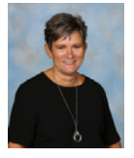
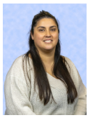
Meet the Teachers
Elder Class
Class Teacher- Miss Drage
Class Teaching Assistant- Mrs Pugh
Oak Class
Class Teacher- Mr Tustin
Class Teaching Assistant- Miss Edgar
Notes:
Elder – teachers for the rest of the year.

Slide 3
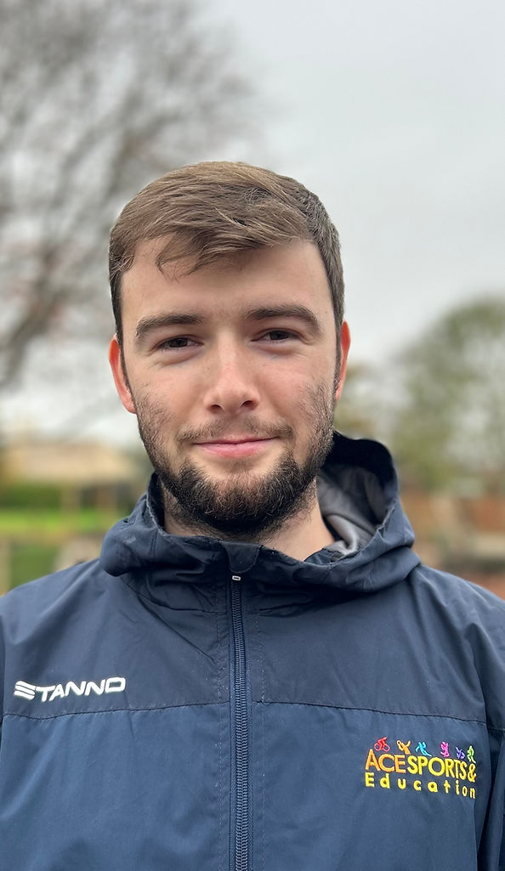
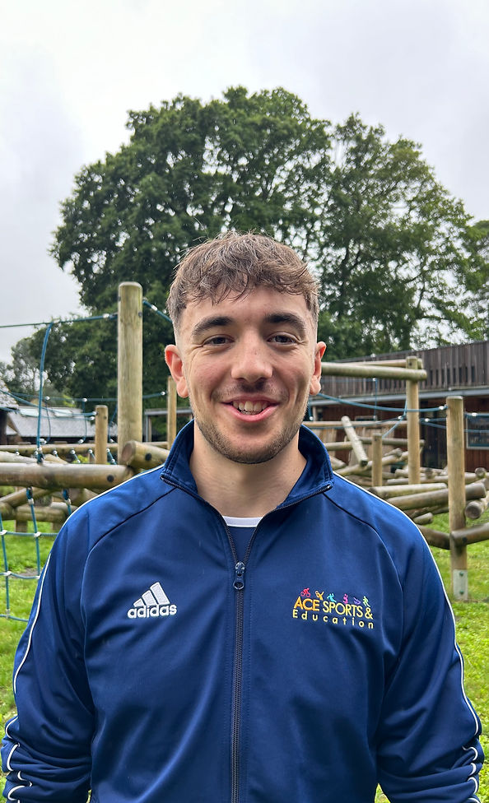
PPA Cover (Thursdays)
Jack Carrett
PE Teaching with ACES Sports on a Thursday morning.
Autumn-health and wellbeing orienteering, invasion games, tag rugby.
Spring- Gymnastics, health and wellbeing, dance, invasion games, netball and hockey
Summer- tennis, athletics, cricket
Evan Thorne

Slide 4
Curriculum Overview

Slide 5


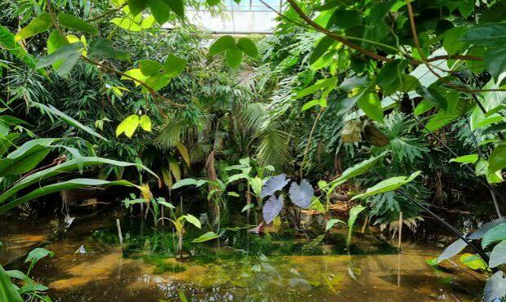
Proposed Trips and visits
Examples of possible trips in line with our curriculum:
Winchester Science Centre (Space)
Southampton City Visit (Urban sketching)
- The Living rainforest, Thatcham (South America)

Slide 6







Our text drivers are:

Slide 7
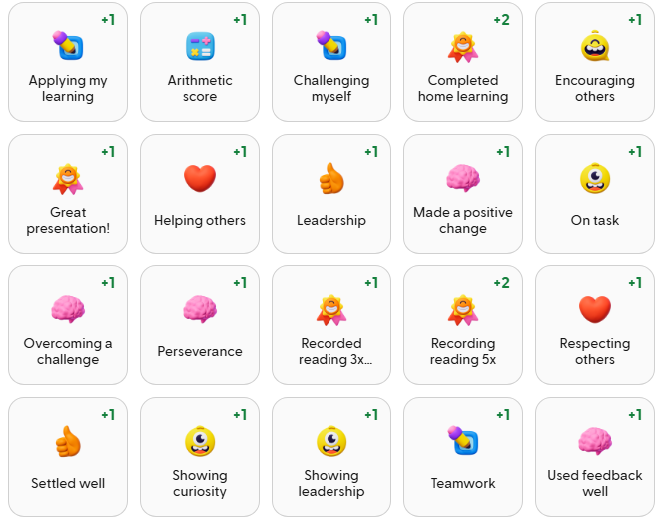
Class Dojo
We will be continuing using Class Dojo this year to reward children for their efforts. Certificates will be given every 50 points and children can work together to earn class rewards.
Information about learning will be posted on our class stories, so keep an eye

Slide 8
Home Learning
Home Learning is sent out on Thursday and should be returned on or before the following Thursday. Children will be given a printed copy, a digital copy will available on Google Classroom as a backup.
Each week, homework will be a spelling sheet in addition to English, Maths or a foundation subject.
They have access to Times-Table Rockstars - online platform for children to complete their tables and compete against each other!

Slide 9
Reading for pleasure
We encourage children to read everyday, developing a habit for reading for pleasure is proven to be extremely beneficial for success in school and life.
Children who read and record in their handbook will receive weekly dojo points.
Children may borrow books from the school library or class reading corner.
Year 5 will have a class visit to the library on a Thursday.

Slide 10
Handbooks
Your child has been issued with a Handbook.
Please ensure your child brings this into school every day.
The Handbook is also a reading log for you and your child to record their reading.
Messages for your child’s teacher can also be recorded in this book.

Slide 11
Leaving school without an adult
If you would like your child to leave school without an adult, please inform the office who will update their permission record.

Slide 12
Foxhills Website
Our School Website is a good place to access relevant information.
https://www.foxhills-jun.hants.sch.uk/

Slide 13
Who to ask…
We hope you won’t have any problems throughout the year. If you do, here are some tips to help you sort it out quickly and effectively.
Class teacher is the first port of call for any and all issues.
Mrs Howe ( Head teacher)
Mrs James (Deputy Head and SENCO)
Mrs Foster (Assistant Head)
Mrs Ferris (Assistant Head)
Mrs Kealey (SENDCO)

